Slide 1

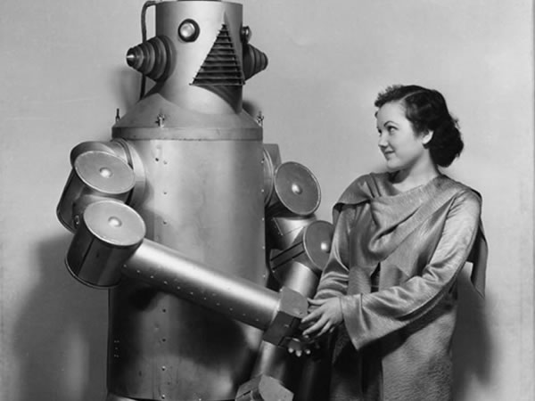
Auto-IA Workshop HMTM Hannover
TEXT MINING FOR SOCIAL SCIENTISTS
Lexicometrics
Gregor Wiedemann | g.wiedemann@leibniz-hbi.de
Media Research Methods Lab
Leibniz-Institute for Media Research | Hans-Bredow-Institut
Andreas Niekler | aniekler@informatik.uni-leipzig.de
Abteilung Automatische Sprachverarbeitung, Institut für Informatik
Universität Leipzig

Slide 2
This lecture
Frequency analysis
Key term extraction
Cooccurrence analysis

Slide 3
Frequency analysis

Slide 4
Frequency analysis
Motivation: Analysis: comparing frequencies of units of analysis per context
  1) between different UoA
  2) in different collections
  3) over time
Possible Units of Analysis (UoA):
  terms → in CA we often will concentrate on those
  concepts (set of terms), ...
  documents, paragraphs, ...
  linguistic units (sentences, punctuation marks, vowels, …)
Context Units
  term frequency: frequency of a term within a document / entire collection
  document frequency: frequency of documents containing a term

Slide 5
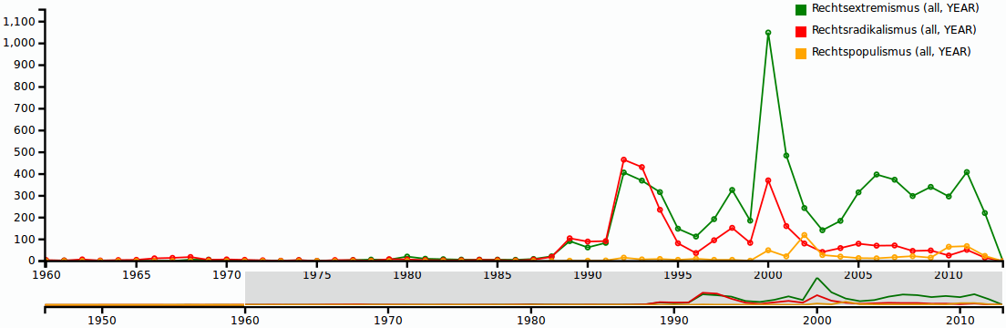
Frequency analysis
Problems of „term as events“:
  distribution of language data → keep Zipf's law in mind
  „burstiness of terms“
    → probability of a word occuring again after seen once increases drastically
    → use log(tf(w)) or df(w) ?
  varying collection sizes → normalize frequencies by collection size!

Slide 6
Zipf's law
George K. Zipf 1935: observation on distribution of terms in a corpus
  List types of a corpus by frequency (n) and assign a rank (r) such that the most frequent type has rank 1
  rank of a word multiplied by its frequency is roughly constant (k):
  r × n ≈ k
type | frequency n | rank r | r * n
sich | 1.680.106 | 10 | 16.801.060
immer | 197.502 | 100 | 19.750.200
Mio | 66.116 | 500 | 18.059.500
Medien | 19.041 | 1000 | 19.041.000
Miete | 3.755 | 5000 | 18.775.000
vorläufige | 1.664 | 10000 | 16.640.000
Implication: from Zipf's Law can be derived that roughly 50% of the vocabulary occurs only once in every document/collection!
(see Heyer/Quasthoff/Wittig 2006)
[Data: Projekt „Deutscher Wortschatz“]

Slide 7
Aggregation / Normalization
analytic insights in frequency analysis comes from relating / comparing frequency information (→ e.g. time series)
frequencies are easily summable to create information on higher / more abstract levels
  tf(w, d) – frequency of term w in document d
  tf(w, m) – sum of tf(w, d) for all d in month m
  tf(w, y) – sum of tf(w, y) for all d in year y, or
  tf(w, m) for all m in y
in many cases absolute frequencies may be hard to interprete
normalization: relative frequencies by all terms/documents in base population
Dy – set of documents in year y
V – vocabulary

Slide 8
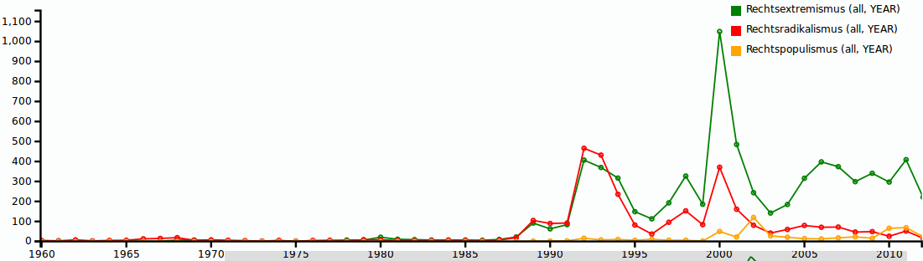
Frequency analysis

Slide 9
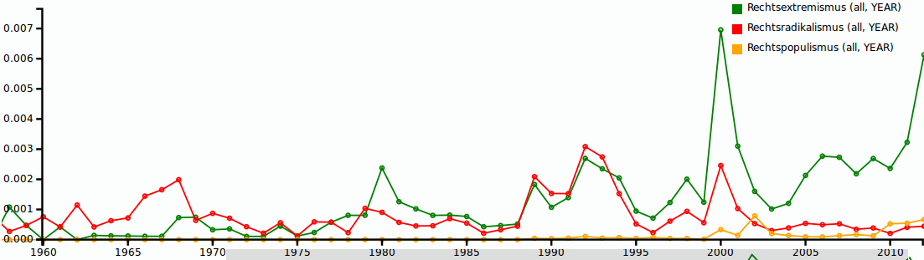
Frequency analysis
relative scale (document frequencies)

Slide 10
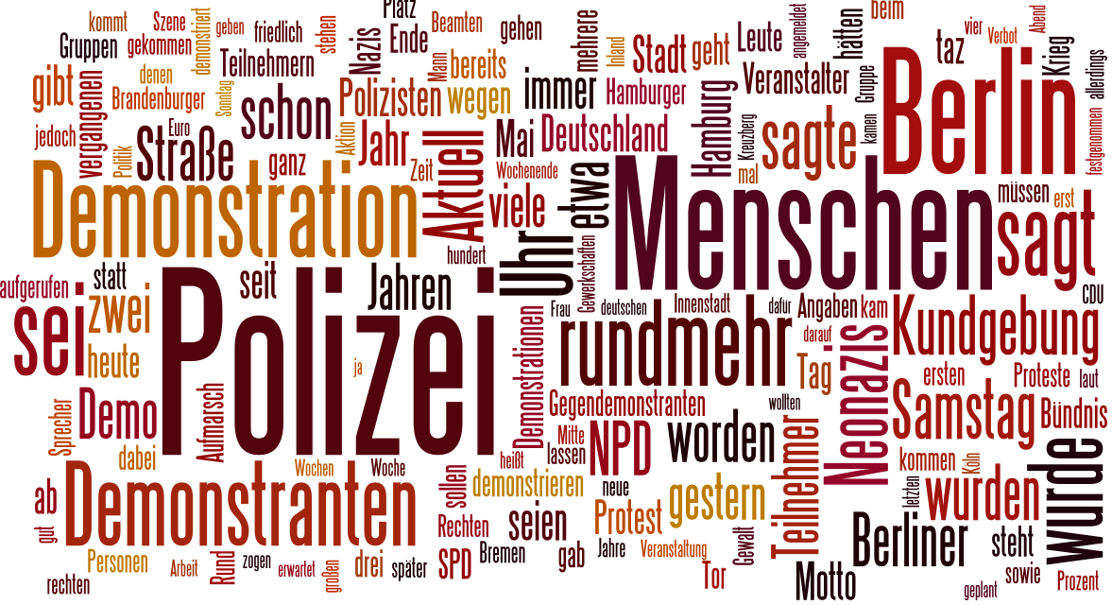
Visualization as word clouds

Slide 11
Concepts / dictionaries
dictionaries (list of words) may be compiled to count conceptual events
  e.g. basic approach of sentiment analysis → identification of subjective mood in source materials
    positive terms: {good, awesome, brilliant, gorgious, ...}
    negative term: {bad, aweful, horrifying, devastating, ...}
  intersection of discoursive fields:
    war terminology: {blitz, bomb, formation, neutral zone, red zone, kamikaze, …}
    measured in articles about soccer, american football or quidditch
  operationalization of theoretical hypthothesis
    TINA rethorics: {no alternative, no other possibility, impossible, indispensable, …}
    with respect to different policy fields
caution:
  Should all events count equally? (e.g. sentiments)
  does occurrence match appropriate context? (feature-/aspect based sentiments)
→ Tutorial 3

Slide 12
Applying frequency analysis
Context matters!
  counting simple occurrence usually neglects contexts
  but, right contexts can be assured by previous selection strategies
    e.g. counting „no alternative“ in documents on European politics compared to a general corpus
  ← Applying filter beforehand increases chances to generate informative data
Utilization of frequency data for description / identification of
  content shares → e.g. pie chart
  trends / time series → e.g. line chart
consider normalization strategies

Slide 13
Key term extraction

Slide 14
Key term extraction
One task, many names:
  „Terminology mining, term extraction, term recognition, or glossary extraction, is a subtask of information extraction. The goal of terminology extraction is to automatically extract relevant terms from a given corpus.“ [Wikipedia]
Extended task: „Ontology learning“
  key terms and their (hierarchical) relationships (e.g. is-a, part-of, hypernym/hyperonym, synonym/antonym relations)
Evaluation:
  judgements on relevancy done by human experts
approaches based on:
  Frequency
    Frequency
    TF-IDF
  Difference corpus
    Log likelihood
    Characteristic elements diagnostics

Slide 15
Frequency
Assumption
  the more frequent, the more important
  removing stop words helps to identify more relevant terms
Evaluation
  language is Zipf distributed
  raw frequency does not cover relevancy well
example:
  protest data TAZ (2000-2009)
approach to get n most relevant terms
  create DTM from corpus
  compute vector v of column sums
  order v in decreasing order
  output item 1 to n of v

Slide 16
type/frequency |  | type/frequency (sw removed)
die | 22807 | polizei | 2072
der | 19938 | menschen | 1492
und | 11426 | demonstration | 1105
den | 7180 | berlin | 982
das | 5560 | uhr | 968
von | 5145 | demonstranten | 961
auf | 5013 | kundgebung | 700
mit | 4957 | samstag | 666
sich | 4668 | neonazis | 651
dem | 4205 | worden | 632
ein | 4188 | straße | 625
nicht | 3909 | npd | 572
für | 3858 | berliner | 558
eine | 3625 | jahr | 537
ist | 3486 | jahren | 534
des | 3308 | teilnehmer | 532
sie | 3299 | rechten | 484
auch | 3115 | seien | 477
gegen | 3070 | demo | 472
als | 2521 | motto | 459

Slide 17
TF-IDF
remember TF-IDF from Information Retrieval:
  relevancy is correlated with term frequency and inversed document frequency

Slide 18
polizei | 7.089975
rund | 6.731556
neonazis | 6.309970
uhr | 6.270761
samstag | 6.236580
kundgebung | 6.021211
menschen | 5.990043
npd | 5.892383
sie | 5.598942
gestern | 5.563909
ist | 5.556133
etwa | 5.476461
berlin | 5.457175
aufmarsch | 5.453003
demonstranten | 5.437748
hatten | 5.436246
teilnehmer | 5.336355
rechten | 5.246831
nicht | 5.204938
unter | 4.991625

Slide 19
Corpus comparison
Difference based Term Extraction methods follow a different approach:
  comparing frequencies in a target corpus T with frequencies in a general comparison corpus C
  significant deviation in T from expected term distribution measured in C is considered as relevancy criterion
Tests used in CA
  Log Likelihood (Dunning 1993; Rayson/Garside 2000)
  Characteristic elements diagnostics (Lebart/Salem 1994)

Slide 20
Log Likelihood
Contingency Table
Log Likelihood
  E1 = c*(a+b) / (c+d)
  E2 = d*(a+b) / (c+d)
  LL = 2*((a*log (a/E1)) + (b*log (b/E2)))
 | Corpus 1 | Corpus 2 | Total
Frequency of word | a | b | a+b
Frequency of other words | c-a | d-b | c+d-a-b
Total | c | d | c+d

Slide 21
 | LL | Frq
NPD | 7867,59 | 1157
Demonstration | 7789,70 | 1295
Demo | 7098,27 | 829
Demonstranten | 5463,47 | 1042
Kundgebung | 5306,27 | 790
Neonazis | 5224,08 | 751
Polizei | 5165,54 | 2262
Aufmarsch | 3704,68 | 468
Gegendemonstranten | 2811,12 | 320
Neonazi | 2565,88 | 305
taz | 2438,61 | 474
Anti | 2380,52 | 232
Antifa | 2237,23 | 243
Demonstrationen | 1841,17 | 400
Teilnehmer | 1722,93 | 582
Teilnehmern | 1464,79 | 335
Bündnis | 1390,89 | 396
Nazis | 1377,34 | 359
Motto | 1370,38 | 468
Protest | 1324,34 | 412

Slide 22
Summary
lot's of approaches to extract terms...
corpus comparison methods are usually better than frequency based methods
disadvantage?: terms are observed independently of each other
LL and „characteristic elements diagnostic“ well established in corpus linguistic literature

Slide 23
Cooccurrence Analysis

Slide 24
Cooccurrence Analysis
Structuralist semantics (F. de Saussure):
  syntagmatic relation: signifiers which occur conjointly complement w.r.t function and content
  paradigmatic relation: signifiers which occur in similar contexts have similar function w.r.t. grammar and content → cp. distributional hypothesis
Computing cooccurrences
  local context C(w): set of words that occur in the same 'window' as w
  global context G(w): set of words which occur conjointly with w in a statistically significant manner
  windows: sentences, paragraphs, documents, headlines, k left/right neighbour words

Slide 25
Cooccurrence Analysis
The sun is shining. | Csentence(sun) = {The, is, shining}
The sun is burning. | Csentence(sun) = {The, is, burning}
The light is shining. | Csentence(light) = {The, is, shining}
G(sun) = {The, is, shining, burning}
G(sun) ~ G(light)

Slide 26
Cooccurrence Analysis
Counting co-occurrence
  => focus on high frequent events in text data (Zipf's law!)
  maximal frequency pair: „the – of“
Determine significance of co-occurrence
  statistical test measuring „surprise“
  => better captures semantic characteristics of a text
  there is not the single measure

Slide 27
Cooccurrence Analysis
statistical significancy
  measure of deviation from random conjoint occurrence
measurements
  na – windows containing A
  nb – windows containing B
  nab – windows containing A and B
  n – number of all windows
significance measures
  Frequency (baseline*)
  Dice
  Mutual Information
  Log Likelihood
(bag of words within windows)
* remember Zipf!

Slide 28
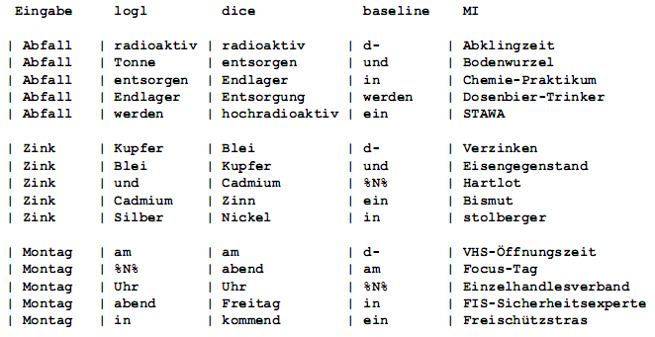
Examples

Slide 29
Application in Social Science
(change of) meaning may be inferred from cooccurrence results
cooccurrence analysis → comparison of different result sets
  change of context units (neighbours, sentence, document, …)
  filter terms by POS-/NE-types
  tracking change of global contexts by comparing time ranges
Visual analytics:
  tables
  graphs
  KWIC-Lists

Slide 30
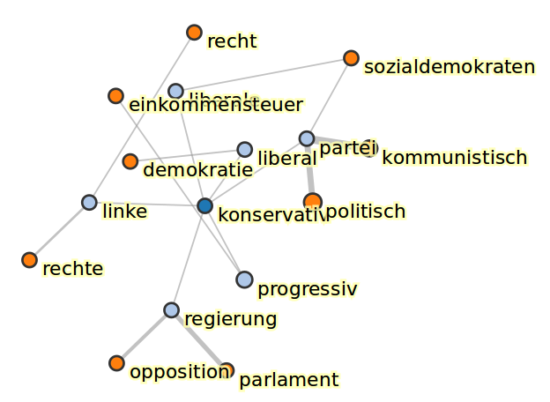
Visualization
cooccurrences = network structure → visualization as graph
  nodes : terms
  edges : cooccurrence relation
e.g. additional information:
  edge width: significancy value
  node color: order of cooccurrence
Caution:
  algorithms for graph drawing produce outcomes which are not necessarily semantically interpretable!

Slide 31
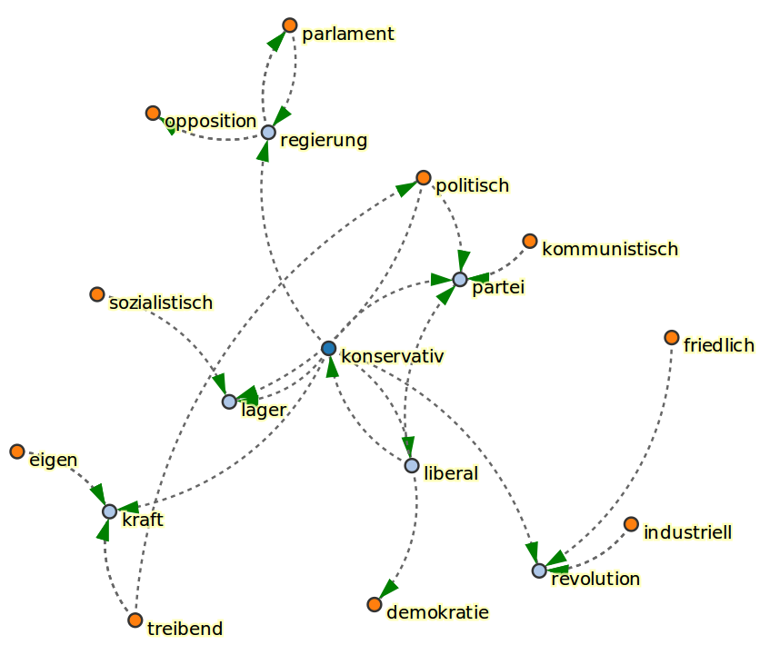
Visualization

Slide 32
Visualization
KWIC-lists: „Keyword in context“ (H.P. Luhn, 1966)
  selection of snippets by single keyword
  centering display around key word
… Antitrustpolitik unterstützten Festhalten an | konservativen | Idealen, die der modernen …
… Die FDP steht für liberal | konservativen | Egoismus. Wofür stehen AL …
… und Sozialpolitiker sind ratlos. | Konservative | Politiker plädieren für härtere Strafen …
… auf den massiven Widerstand der | konservativen | Mehrheit im Bundesrat. Ihr …
… Sozialisten), manche Engländer (vornehmlich | Konservative | ) und Italiener (vor allem …
… an anderen geschliffen. Der | konservativen | Regierung Margaret Thatchers fällt …
… Radikalen unter ihnen haben die " | konservative | Revolution" auf ihr Panier geschrieben. …

Slide 33
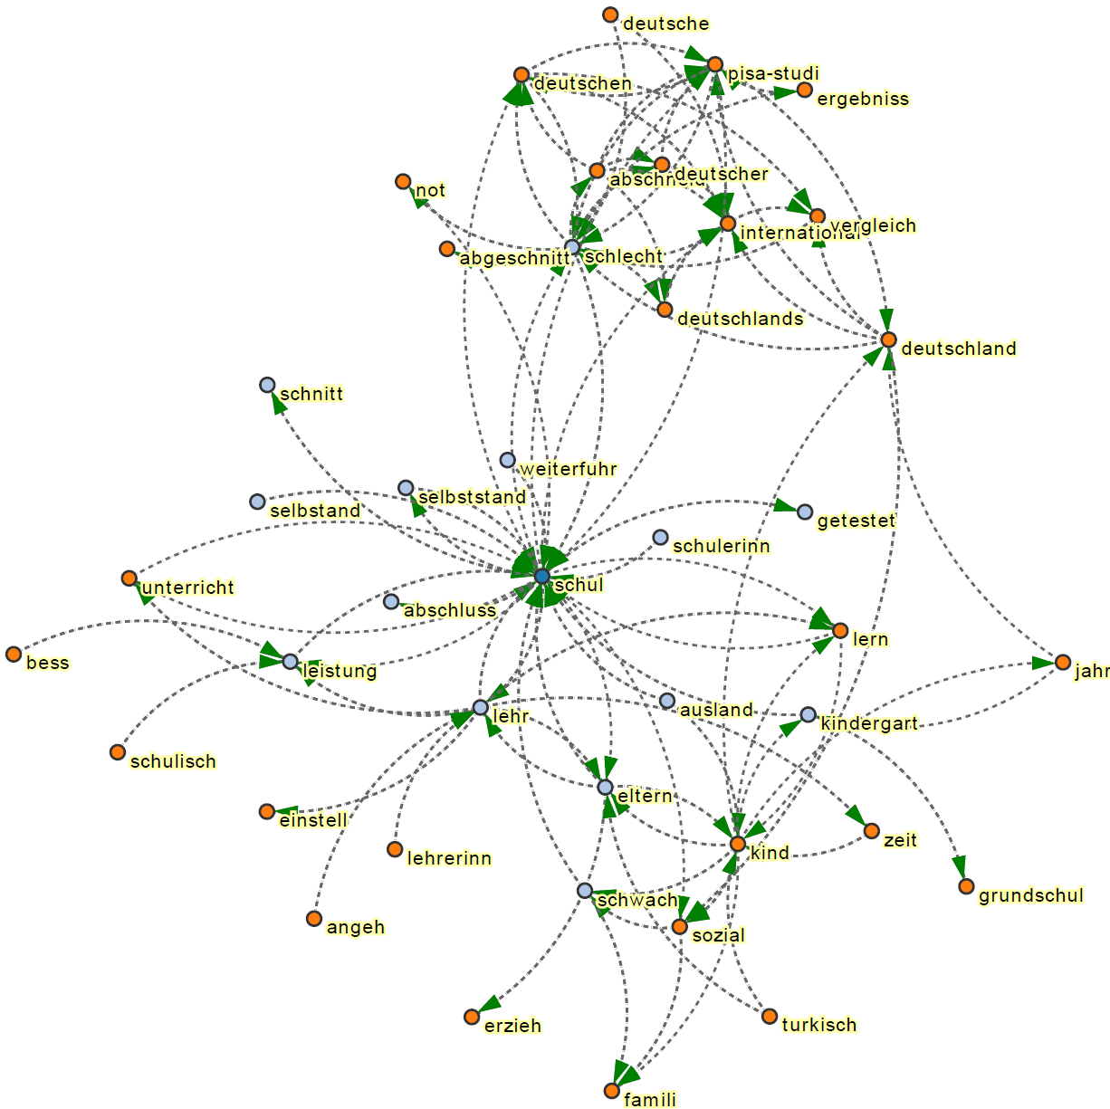
change of contexts
[Maas 2015]:
Kookkurrenzen
zu „Schule“
PISA-Studie,
2001/02
PISA shock

Slide 34
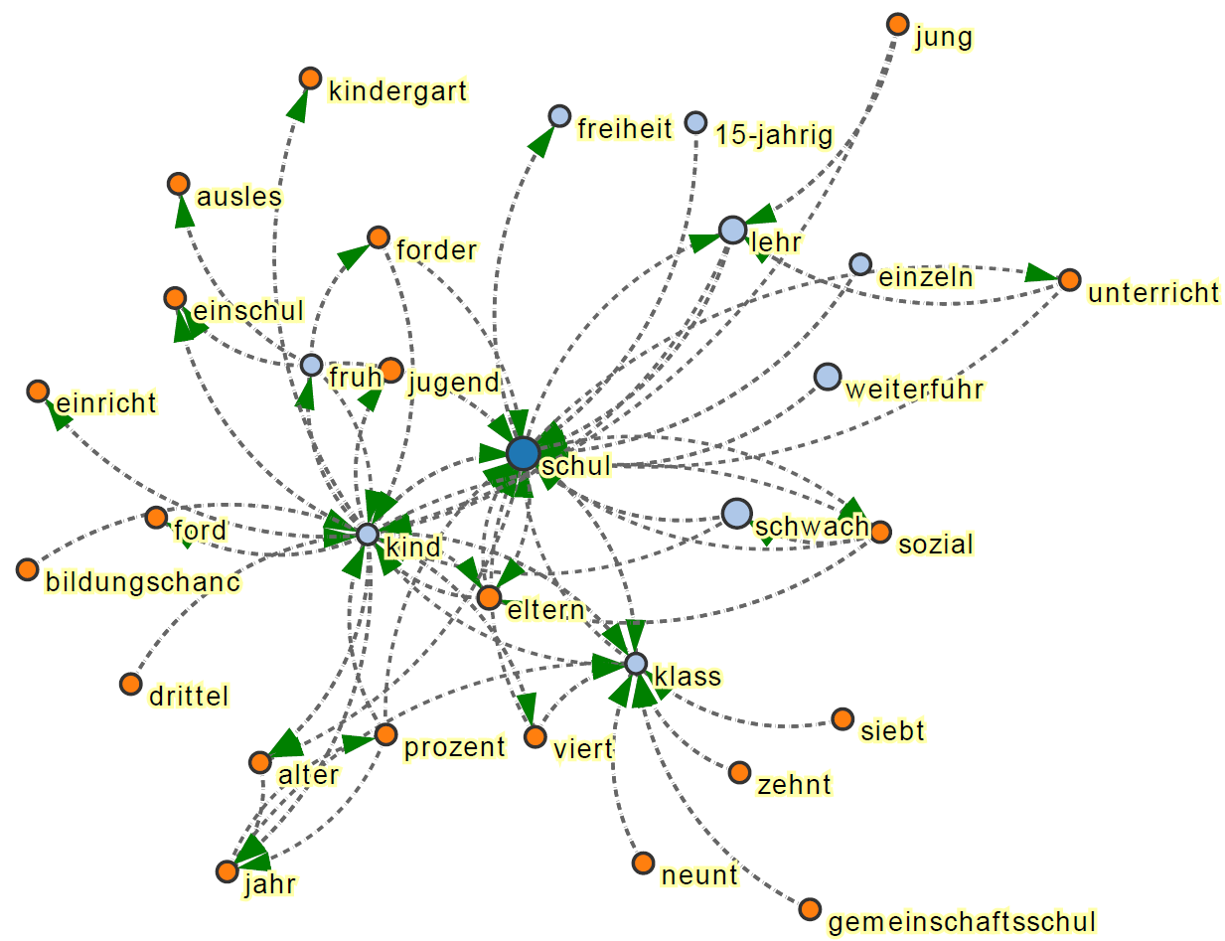
change of contexts
[Maas 2015]:
Kookkurrenzen
zu „Schule“
PISA-Studie,
2004/05
School types

Slide 35
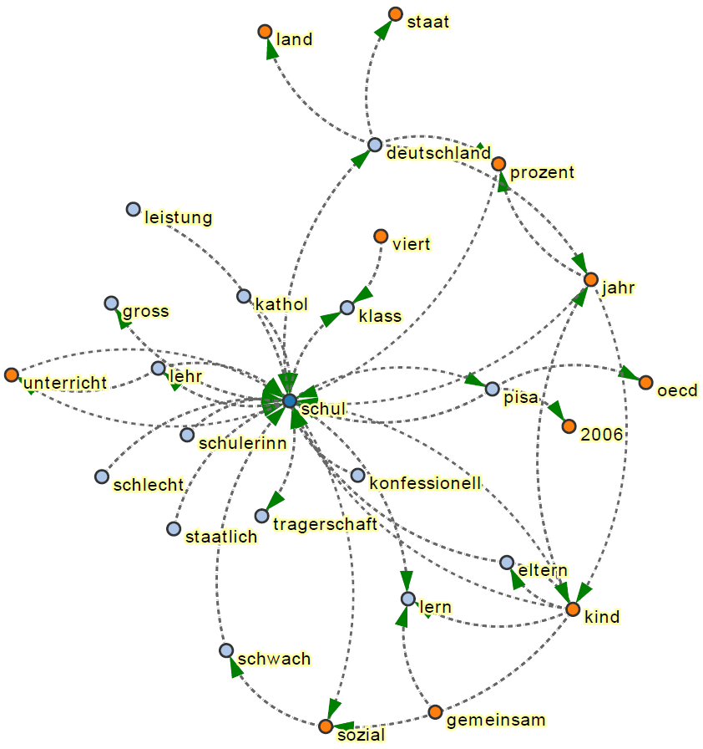
change of contexts
[Maas 2015]:
Kookkurrenzen
zu „Schule“
PISA-Studie,
2007/08
Elementary period
Private/public

Slide 36
Summary
Cooccurrence analysis:
  global contexts → meaning of terms („discourse level“)
  significancy of cooccurrence relation is crucial
„visual hermeneutics“ / distant reading of collections through graphical representations
informational enrichment by creative filtering:
  different sub collections
  time ranges
  person names / NE
  certain POS-types
  ...
What differences in results do you expect from different windows?
sentences
paragraphs
documents
headlines
k left/right neighbour words

Slide 37
Summary Lexicometrics
Applications
  1. Frequency analysis
  2. Key terms / characteristic elements
  3. Concordance (local context) → KWIC lists
  4. Cooccurrence / collocation (global context)
5. application: Dimension reduction by multivariate statistics (not covered in this lecture)
  Multidimendional scaling
  Correspondence analysis
  Prinicipal component analysis
Context selection:
  interpretation of contrasting results of different subselections of the base population

